Slide 1
Poker and AI
Zackary Medeiros

Slide 2
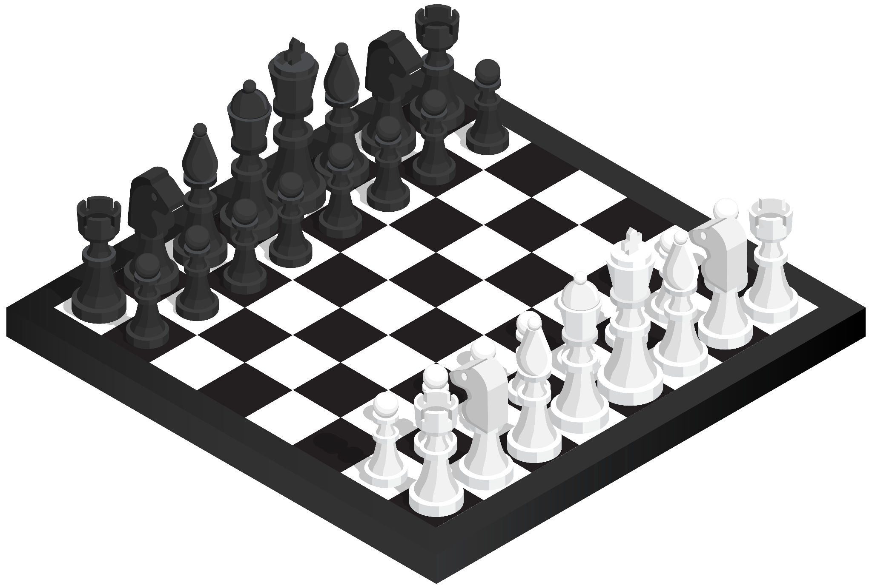
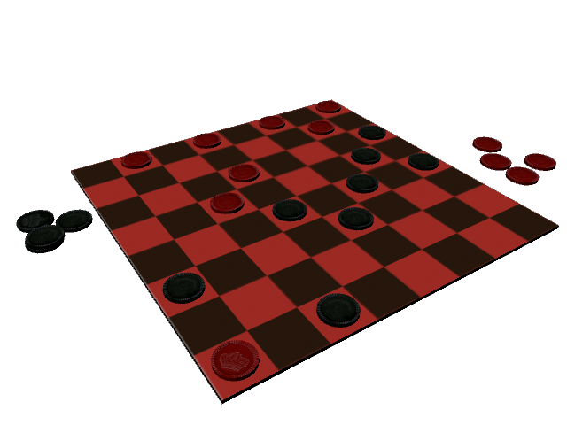
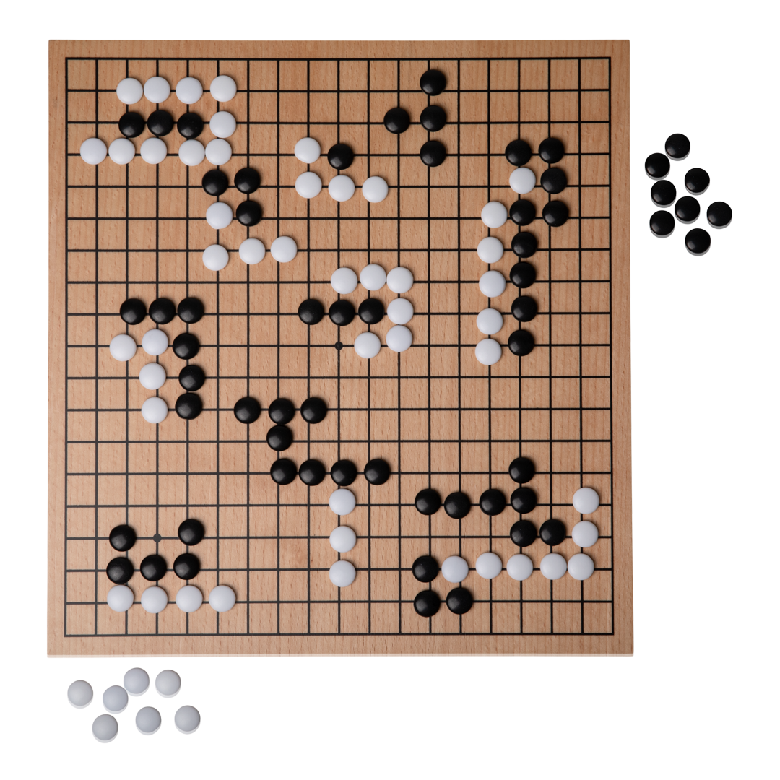
A Brief History Lesson
There have been computer ‘bots’ for games since the creation of computers themselves. The earliest AI chess players came about in the 50’s, but they weren’t very good. It wasn’t until the 90’s until AI’s began to get good at playing games.
AI solved ‘perfect information’ games such as Chess, Checkers, and Go.

Slide 3
Nash Equilibrium, The Goal, Until it wasn’t
“A Nash equilibrium is a situation where no player could gain by changing their own strategy”
This was the original design of game/poker solvers. Oleg Ostroumov created the first poker solver with this in mind.
The solver was used to enhance the skills of top players
Dota 2 and StarCraft 2 have also been solved. It is relatively easy to solve 2 entity (player, team) games compared to 3+ entity games.
Libratus:
Poker AI that doesn’t use Nash Equilibrium. ‘Solved’ HUNLTH. Solved here means it always beat top humans in the long run, and all other AI’s.
Three-pronged approach: Precomputing an overall strategy Adapting the strategy to actual gameplay Learning from its opponent

Slide 4
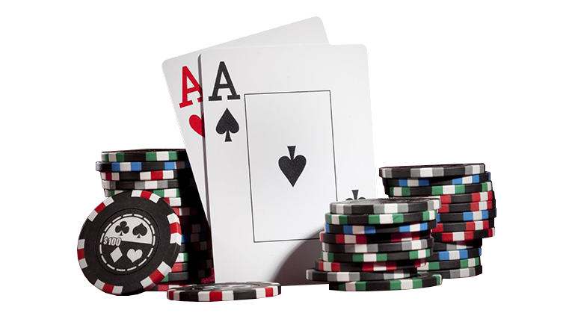
Why does all of this matter
Perfect information AI’s are relatively easy to develop, however they aren’t all that useful. Hidden information AI’s are highly applicable in business strategy, negotiation, strategic pricing, finance, cybersecurity, military applications, etc.. They can even take up less computing resources.
Pluribus:
Multiplayer Playing Bot!
May have solved 6 player NLTH.
Works on more live decisions, therefore there is less information to store, so this model of AI uses less computational resources.
I may be diving into this deeper, it was originally more of a stretch goal, but there seems to be a lot of information out there, and it ties directly from Libratus

